Slide 1

COMPUTER ARCHITECTURE – CSA1221
Instruction Set Architecture Simulator
PRESENTED BY
USHA NANDHINI P
SHREE AISHWARAYA R
SOFIA
GUIDED BY,
DR.K.VIJAYA BHASKAR
Yavanika S [ 192521258 ] – Module 1: Shared Cache Design [ Team Member 2 Name – Reg. No. ] – Module 2: Coherence Protocol [ Team Member 3 Name – Reg. No. ] – Module 3: Performance Evaluation

Slide 2


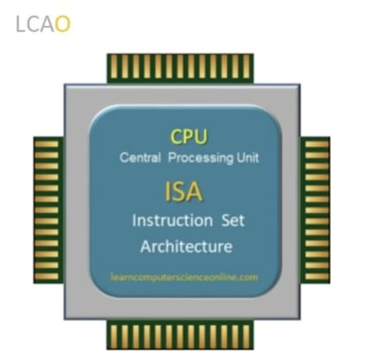
INTRODUCTION
An Instruction Set Architecture (ISA) is the set of instructions that a processor understands and executes.
Every program is converted into assembly instructions before being executed by the processor.
A processor executes each instruction through Fetch, Decode, Execute, Memory Access, and Write Back stages.
An ISA Simulator is a software model that mimics the behavior of a real processor without requiring physical hardware.
It helps visualize how instructions move through the processor and how different hardware components work together.
WITHOUT COHERENCE – AN INCONSISTENT VIEW
Core 0
Core 1
Cache: X = 5
Cache: X = 5
Main Memory: X = 5
Core 0 writes X = 9 in its own cache only → Core 1 still reads X = 5 → inconsistent result.
PROJECT OBJECTIVES
1
2
3
Design a RISC ISA simulator for instruction fetch and decode.
Implement instruction execution using Register File, ALU, and Memory.
Evaluate processor performance using Instruction Count, CPI, and Execution Time.
2

Slide 3
PROBLEM STATEMENT
Understanding how assembly instructions are executed inside a processor is challenging because the internal operations are not directly visible.
The proposed simulator addresses this problem by:
Simulating the execution of RISC assembly instructions.
Demonstrating the interaction between the PC, Decoder, Register File, ALU, and Memory.
Showing how instructions are fetched, decoded, and executed.
Tracking the number of instructions and clock cycles.
Evaluating processor performance using Instruction Count, CPI, and Execution Time.
8

Slide 4
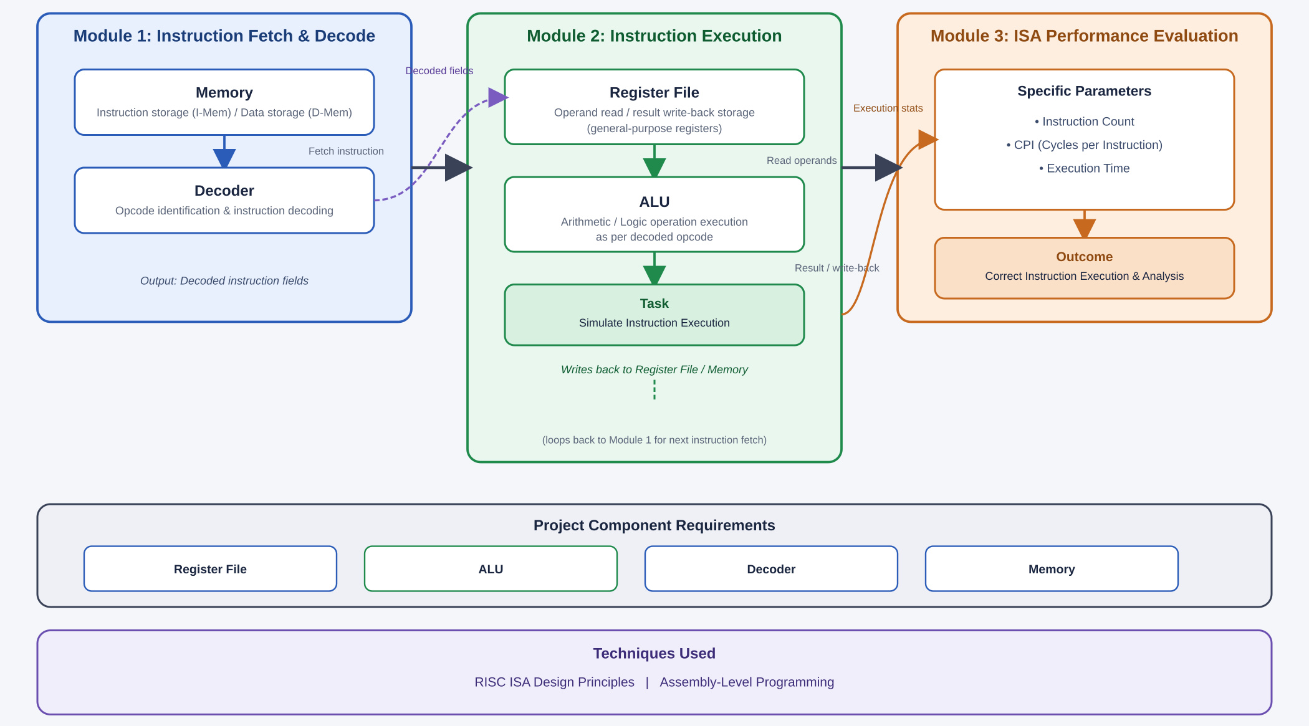
ARCHITECTURE DIAGRAM
8

Slide 5
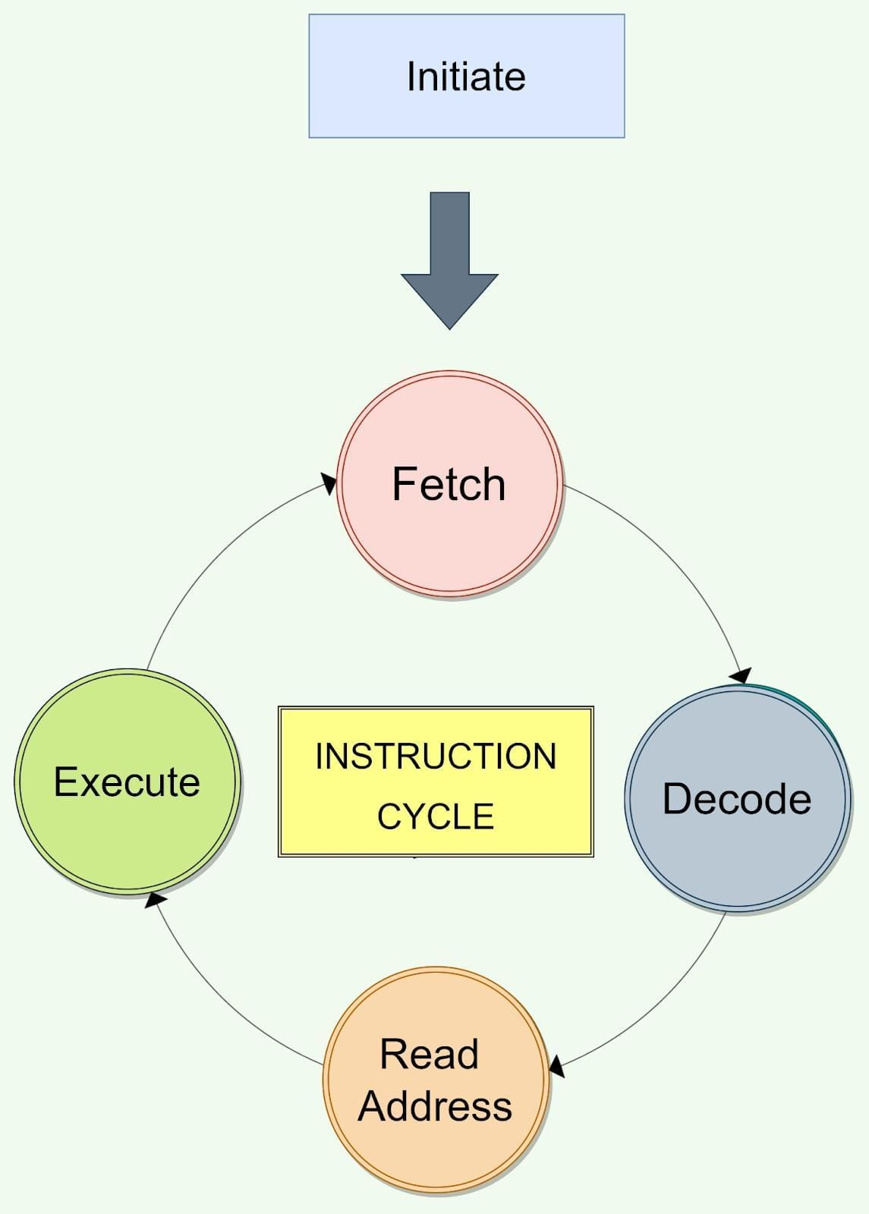
MODULE 1 INSTRUCTION FETCH AND DECODE
Components:
Program Counter (PC)
Instruction Memory
Instruction Register (IR)
Decoder
Register File
Example:
ADD R1, R2, R3
The decoder identifies:
Opcode → ADD
Source Register 1 → R2
Source Register 2 → R3
Destination Register → R1
Process:
Fetch instruction from memory using the PC.
Store the instruction in the Instruction Register.
Decode the opcode and operands.
Identify the required registers and operation.
Update the PC to the next instruction.
5

Slide 6
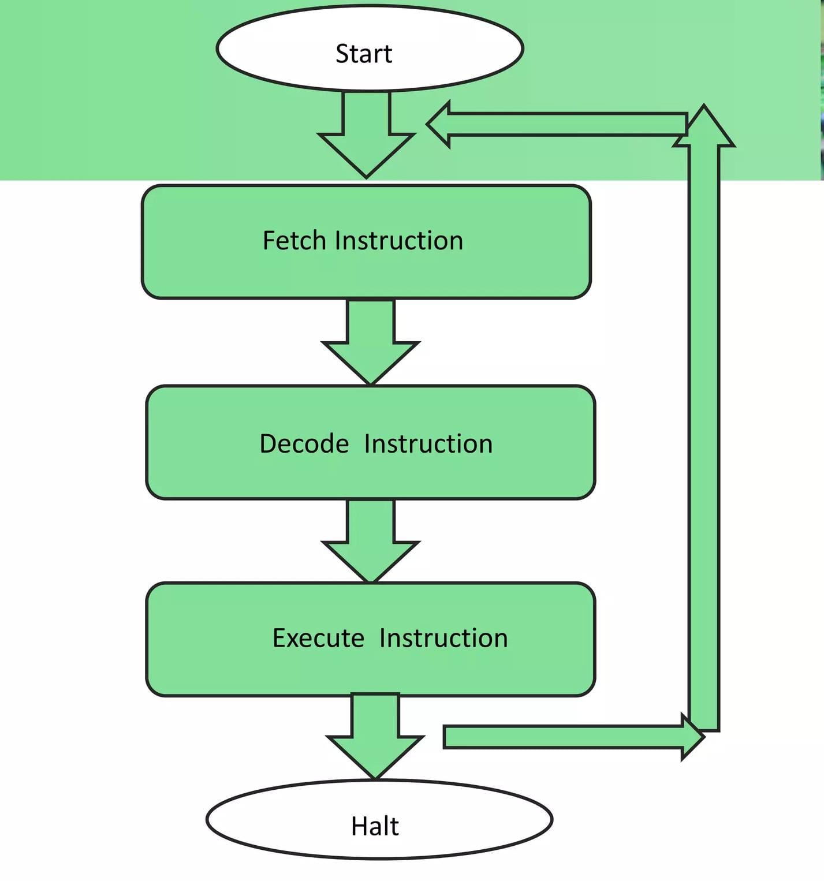
MODULE 2· INSTRUCTION EXECUTION
After decoding, the instruction is executed using the appropriate processor components.
Process
Read operands from the Register File.
Execute operations using the ALU.
Access Data Memory for LOAD/STORE instructions.
Write results to registers or memory.
Proceed to the next instruction.
Example
ADD R1, R2, R3
Given:
R2 = 10
R3 = 20
The ALU performs:
10 + 20 = 30
Final result:
R1 = 30
8

Slide 7
MODULE 3
ISA PERFORMANCE EVALUATION
The simulator should calculate:
Instruction Count
Number of instructions executed.
Instruction Count=Total executed instructions
2. CPI — Cycles Per Instruction
CPI=Instruction Count Total Clock Cycles​
3. Execution Time
Execution Time=Clock Rate Instruction Count × CPI ​
Example
Suppose:
Instruction Count = 100
CPI = 2
Clock Rate = 1 GHz
Then:
Total Clock Cycles = 100 × 2
= 200 cycles
Execution Time = 200 / 1,000,000,000
= 200 ns
Process
Read operands from the Register File.
Execute operations using the ALU.
Access Data Memory for LOAD/STORE instructions.
Write results to registers or memory.
Proceed to the next instruction.
10

Slide 8
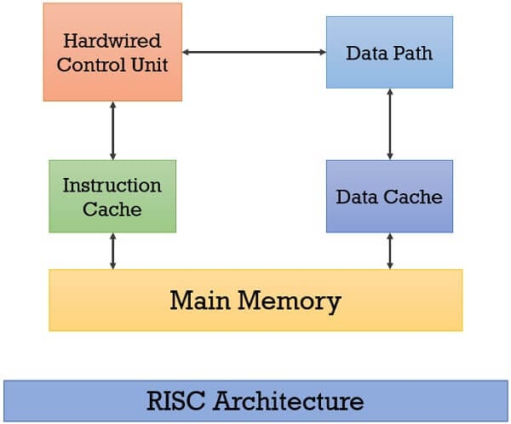
RISC INSTRUCTION SET
The simulator uses a simple RISC-style instruction set.
Instruction | Function
ADD | Addition
SUB | Subtraction
AND | Bitwise AND
OR | Bitwise OR
LW | Load data from memory
SW | Store data into memory
BEQ | Branch if two registers are equal
Example Assembly Program
ADD R1, R2, R3
SUB R4, R1, R5
AND R6, R2, R3
OR R7, R4, R5
These instructions are fetched, decoded and executed sequentially by the simulator.
8

Slide 9
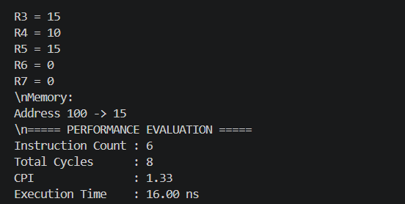
SAMPLE PERFORMANCE ANALYSIS
Assume:
Instruction Count = 100
Total Clock Cycles = 200
Clock Rate = 1 GHz
CPI
CPI=100200​=2
Execution Time
Execution Time = 1×109100×2
​ = 200 ns
Performance Result
Parameter | Value
Instruction Count | 100
Clock Cycles | 200
CPI | 2
Clock Rate | 1 GHz
Execution Time | 200 ns
Final Output
8

Slide 10
DISCUSSION
Advantages, Applications & Future Scope
ADVANTAGES
APPLICATIONS
FUTURE SCOPE
Visualizes processor execution by showing how instructions are fetched, decoded, and executed.
Improves understanding of RISC architecture and assembly language concepts.
Evaluates processor performance using Instruction Count, CPI, and Execution Time.
Computer Architecture laboratories for practical learning and demonstrations.
Assembly language education to understand instruction execution.
Processor design and simulation for academic projects and research.
Add pipeline simulation to improve execution efficiency.
Support advanced RISC-V instructions and additional instruction formats.
Develop a graphical user interface (GUI) for real-time visualization of instruction execution.
13

Slide 11
CONCLUSION
Bringing the Three Modules Together
The Instruction Set Architecture (ISA) Simulator successfully demonstrates the complete instruction execution process, including Fetch, Decode, Execute, Memory Access, and Write Back.
It accurately simulates the functions of the Register File, ALU, Decoder, and Memory while executing RISC assembly instructions.
The simulator evaluates processor performance using Instruction Count, CPI, and Execution Time, making it an effective tool for learning and analyzing computer architecture concepts.
THANK YOU

